Slide 1
NANYONJO BELINDA
23/BIT/BU/R/1017

Slide 2
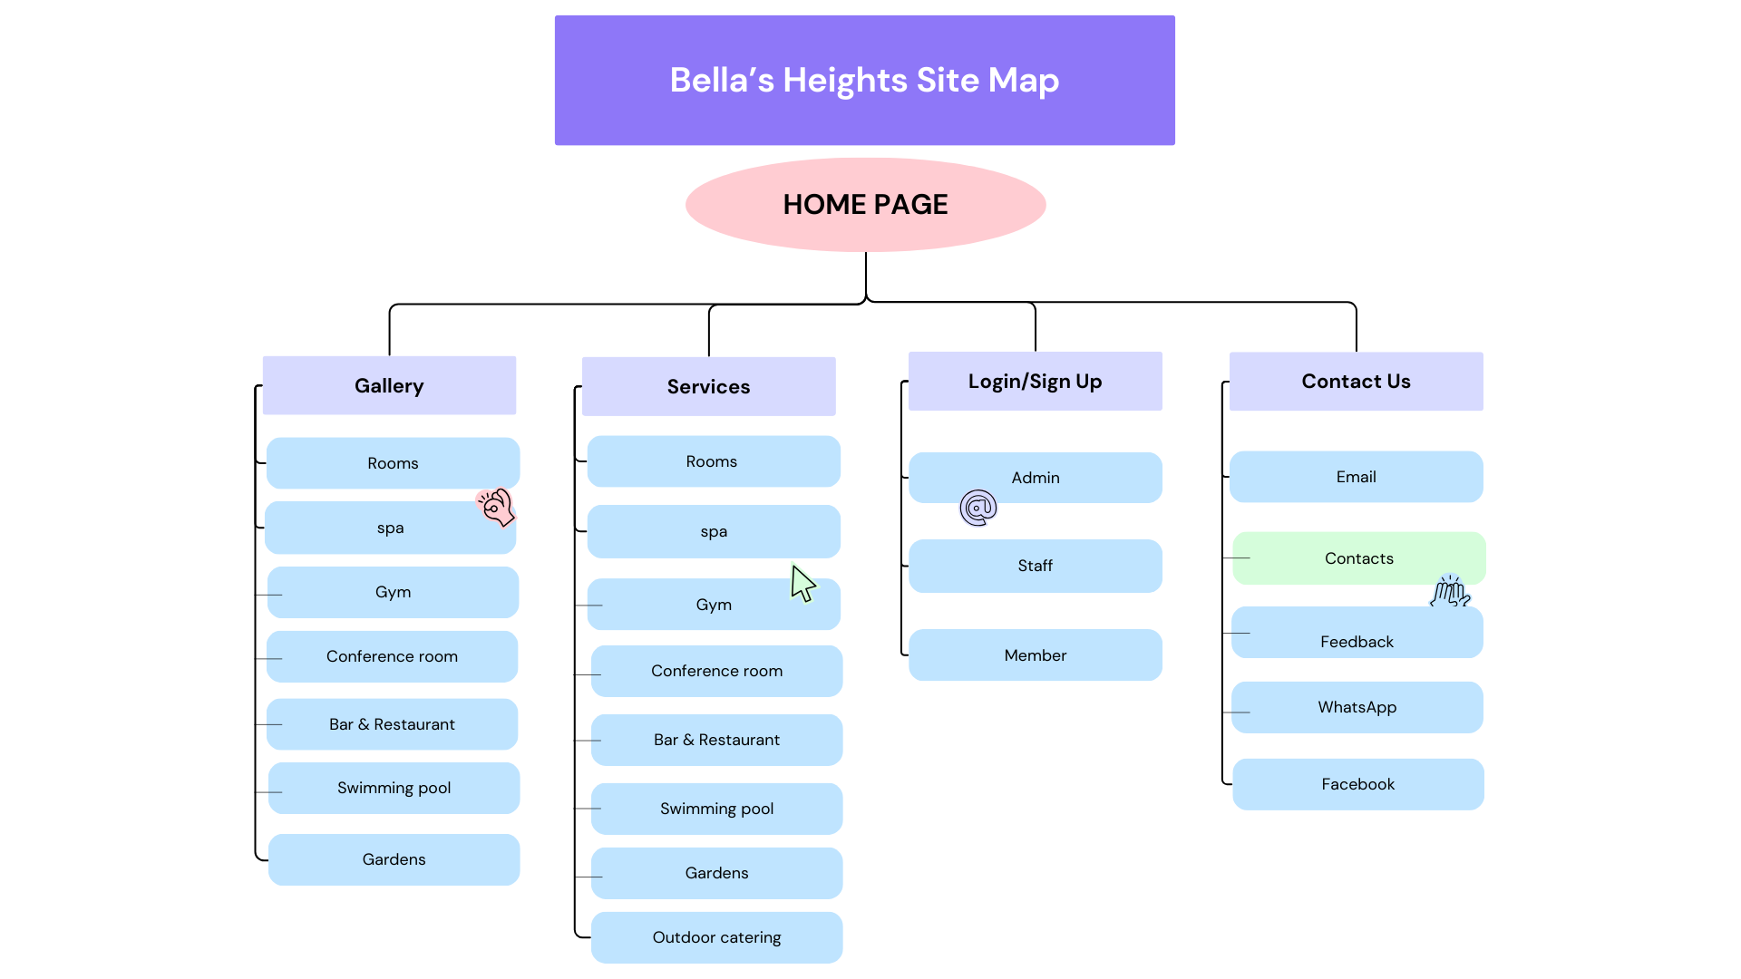
SITE MAP

Slide 3
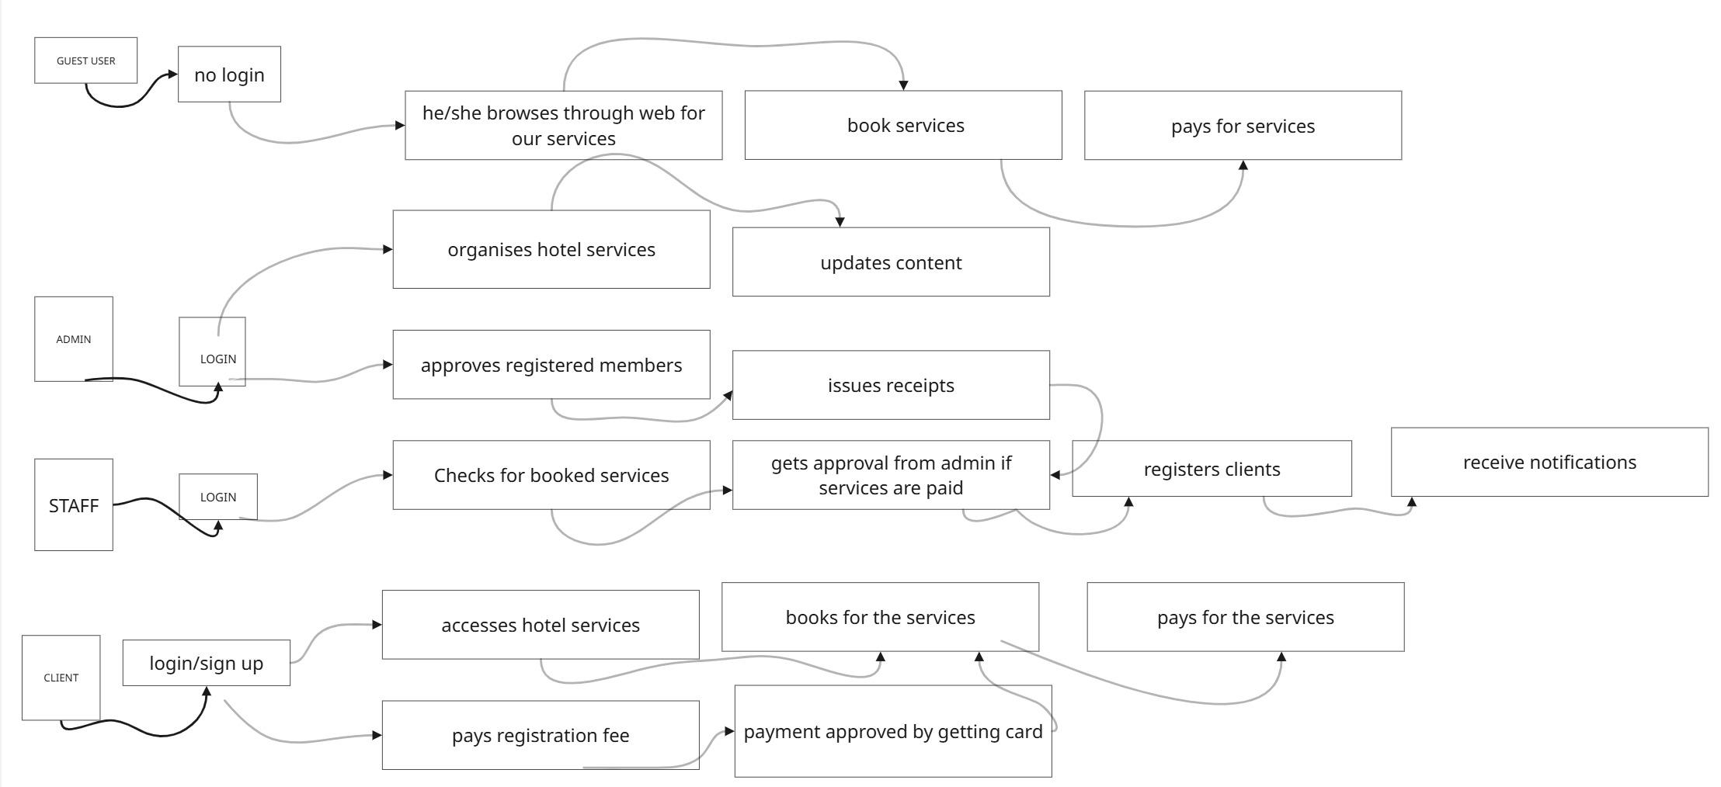
USE-CASE DIAGRAM

Slide 4
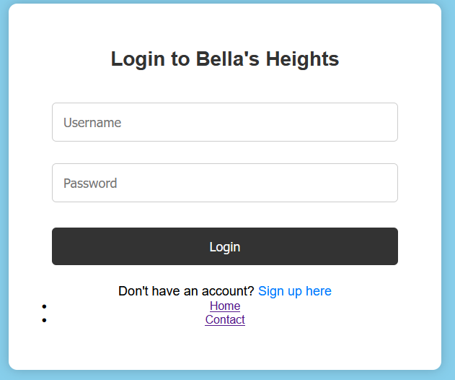
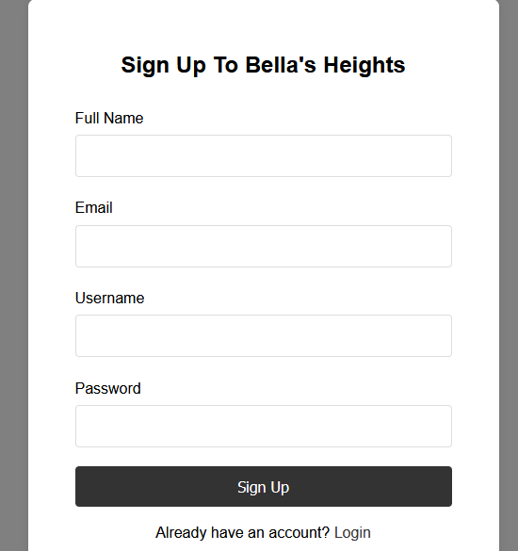
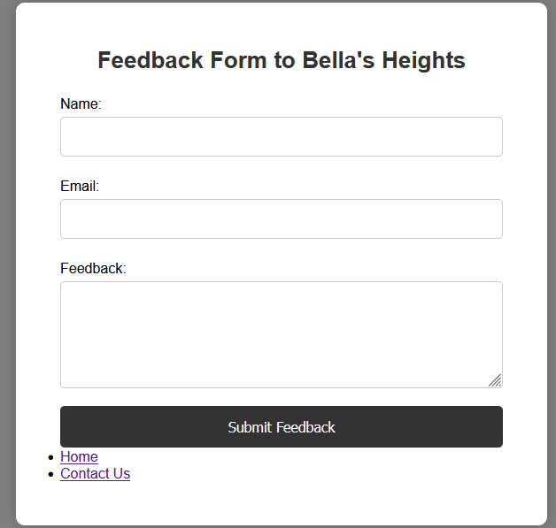
INTERFACE DESIGNS
FORMS

Slide 5


WEB PAGES
Home Services

Slide 6
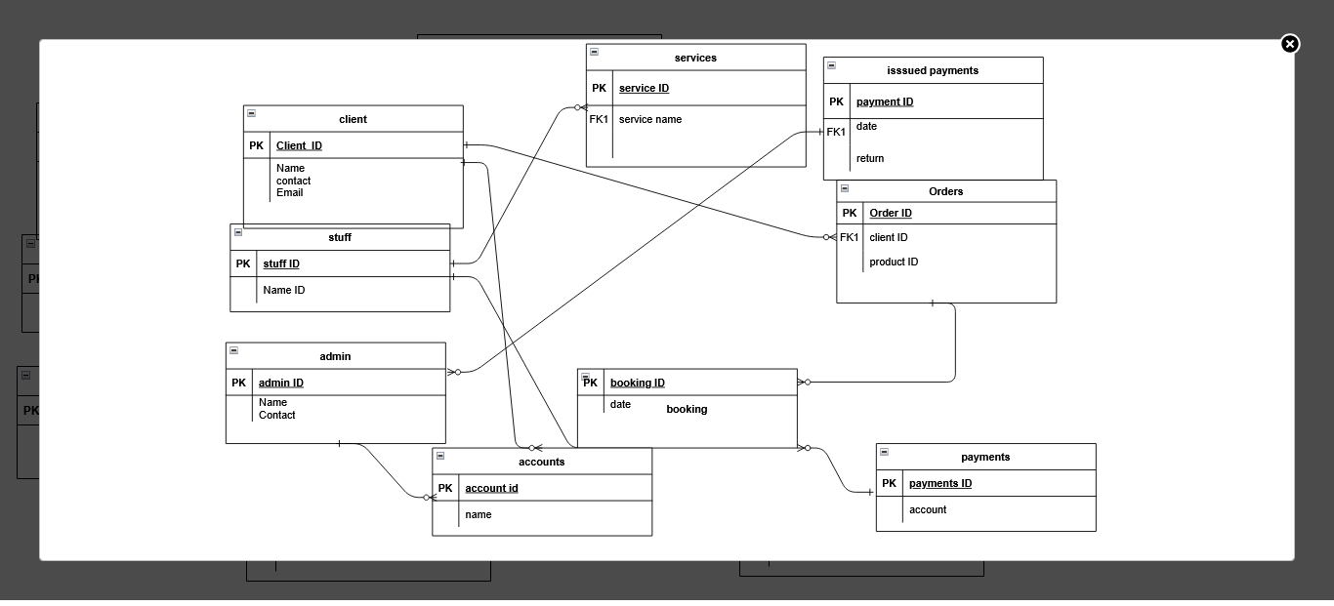
ENTITY RELATIONSHIP DIAGRAM

